Slide 1
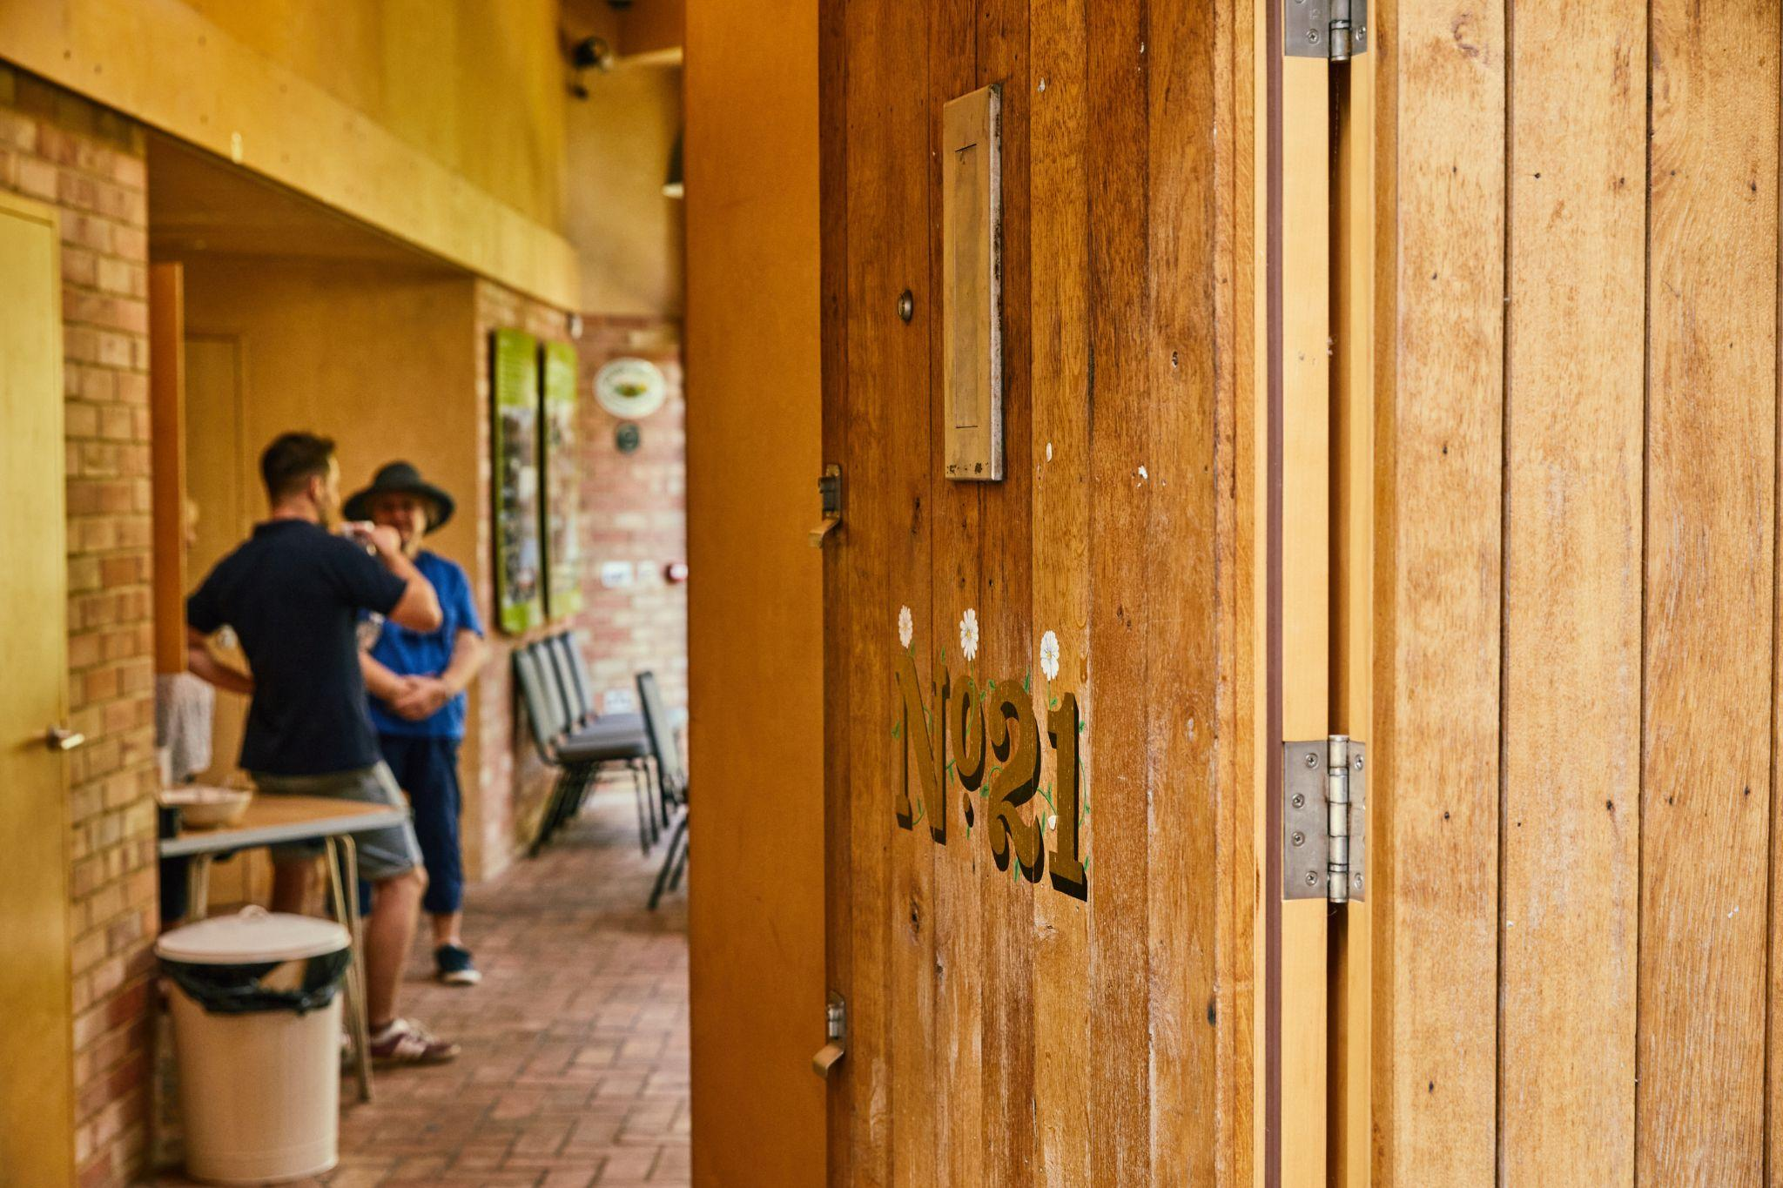
Open House Festival Curatorial Criteria 2024

Slide 2
What do we mean by ‘curatorial criteria’?
Why do we have them?
How do we apply the criteria?
A look at the four sections
Questions

Slide 3
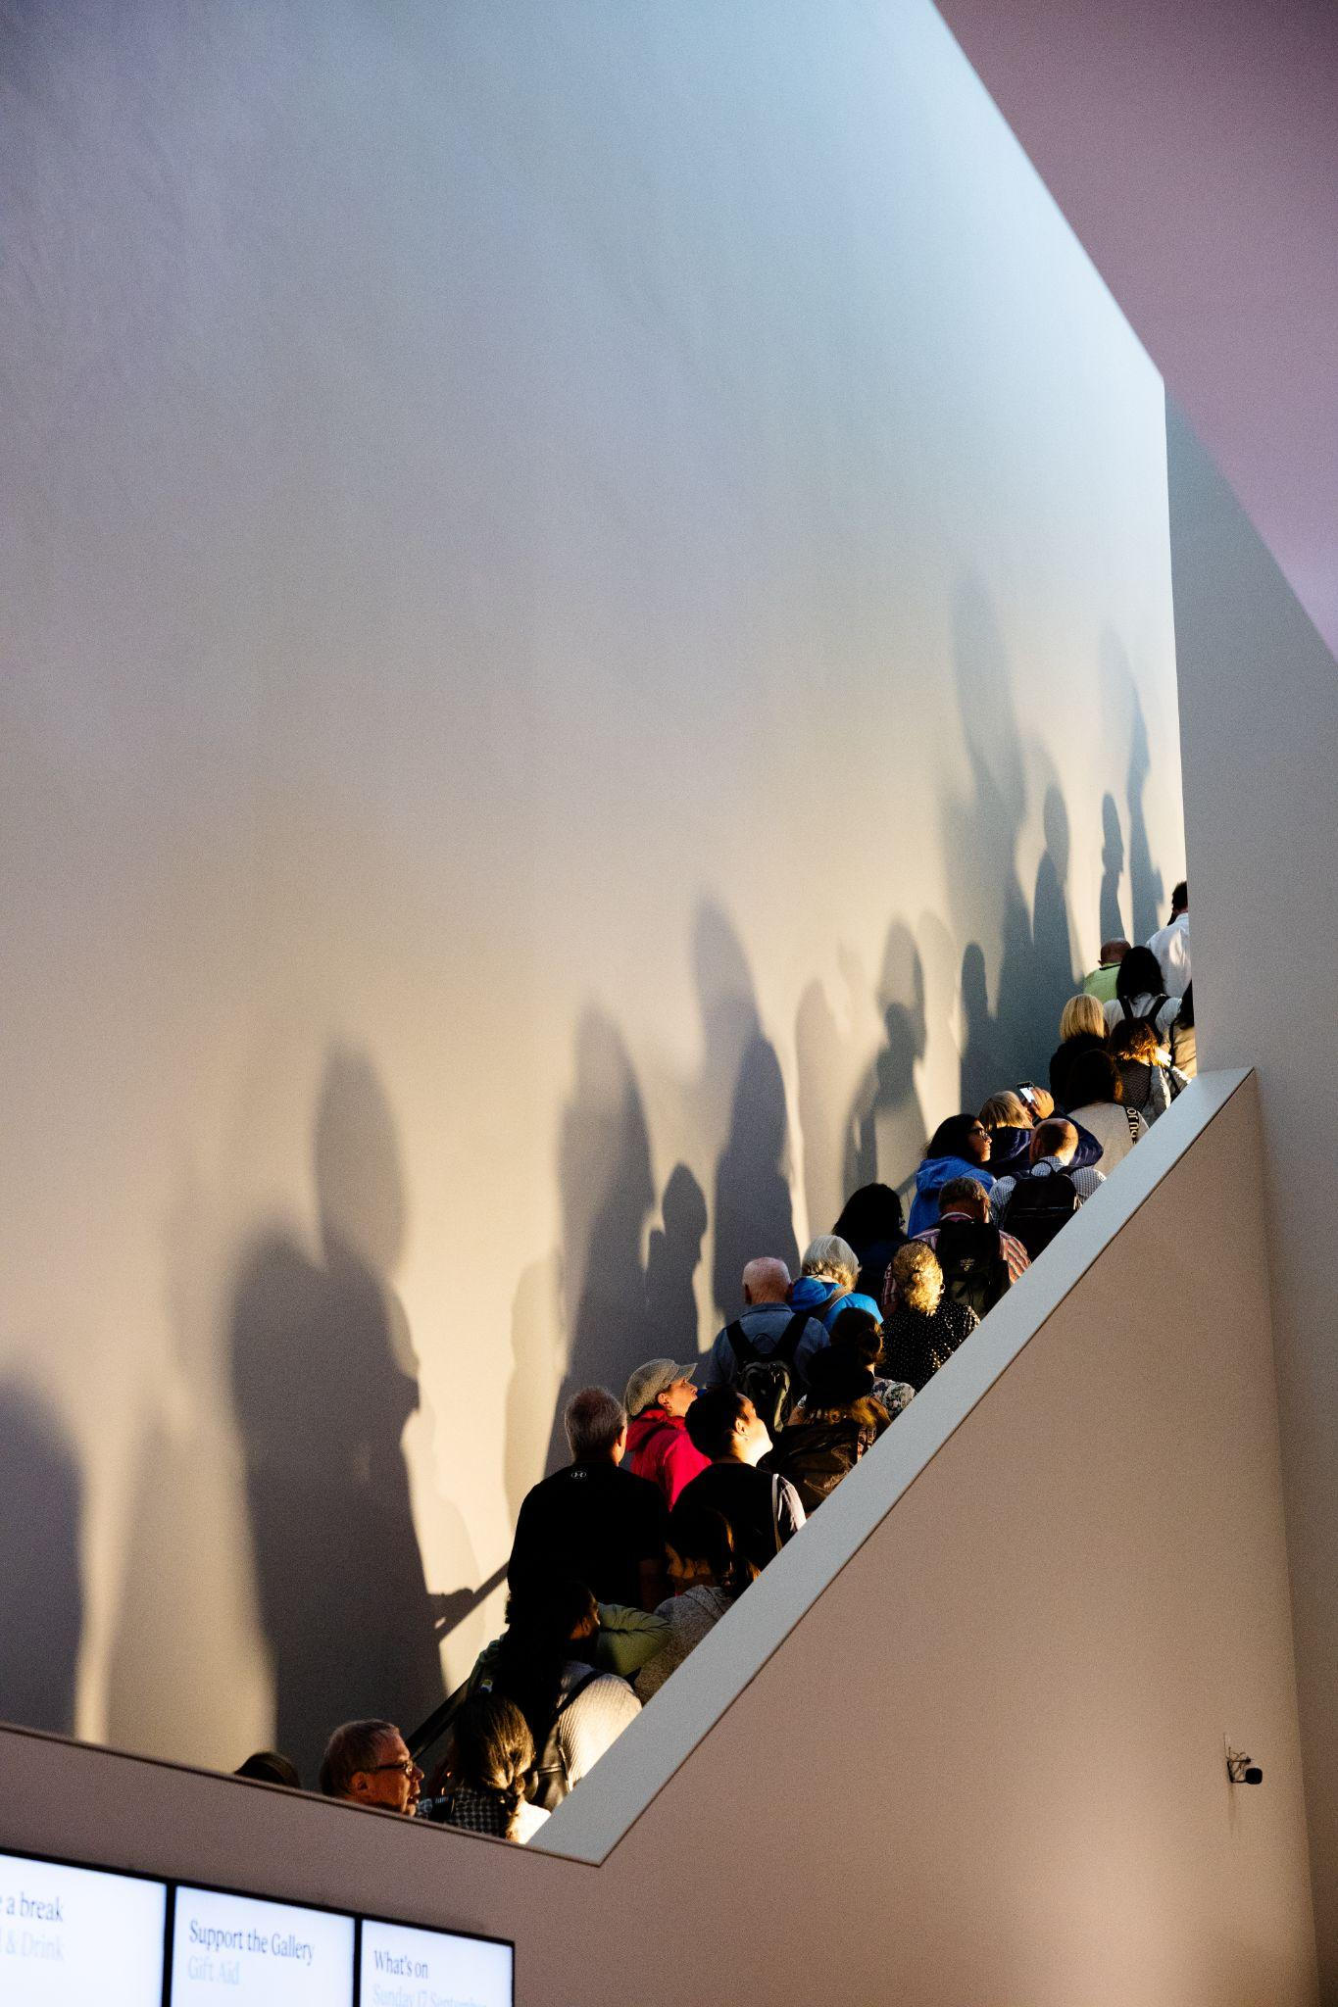
What do we mean by ‘curatorial criteria’?
A document, here
What we’re looking for
Scoring system

Slide 4
Why do we have them?
Consistency
Transparency
Ensure that open days and events champion the festival’s mission
Structure our feedback

Slide 5
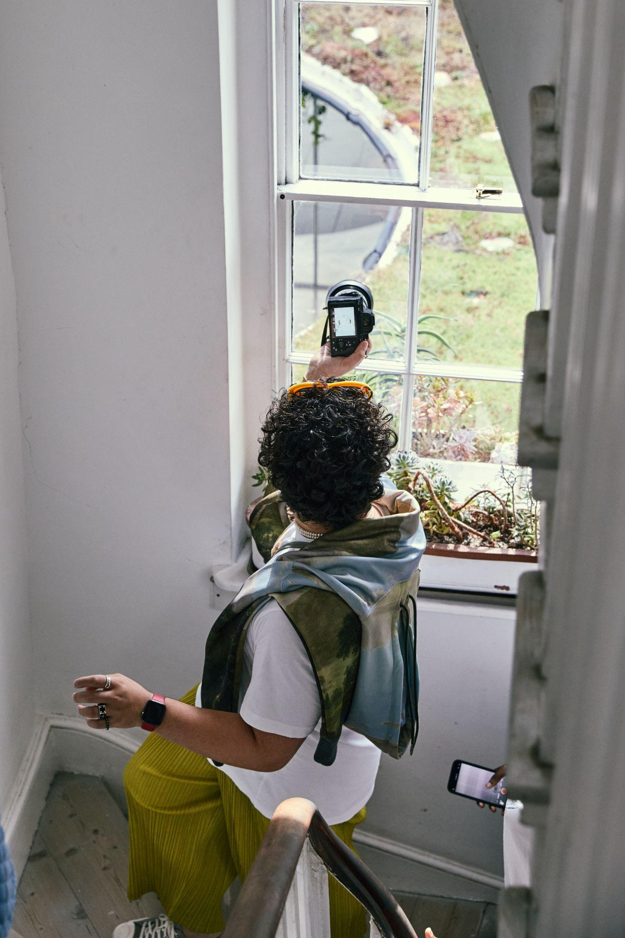
How do we apply the criteria?
When looking at application forms (not expressions of interest)
Look for reasons to include, not to exclude
Scores of 3+ are approved
Give feedback if not scoring at least 3

Slide 6
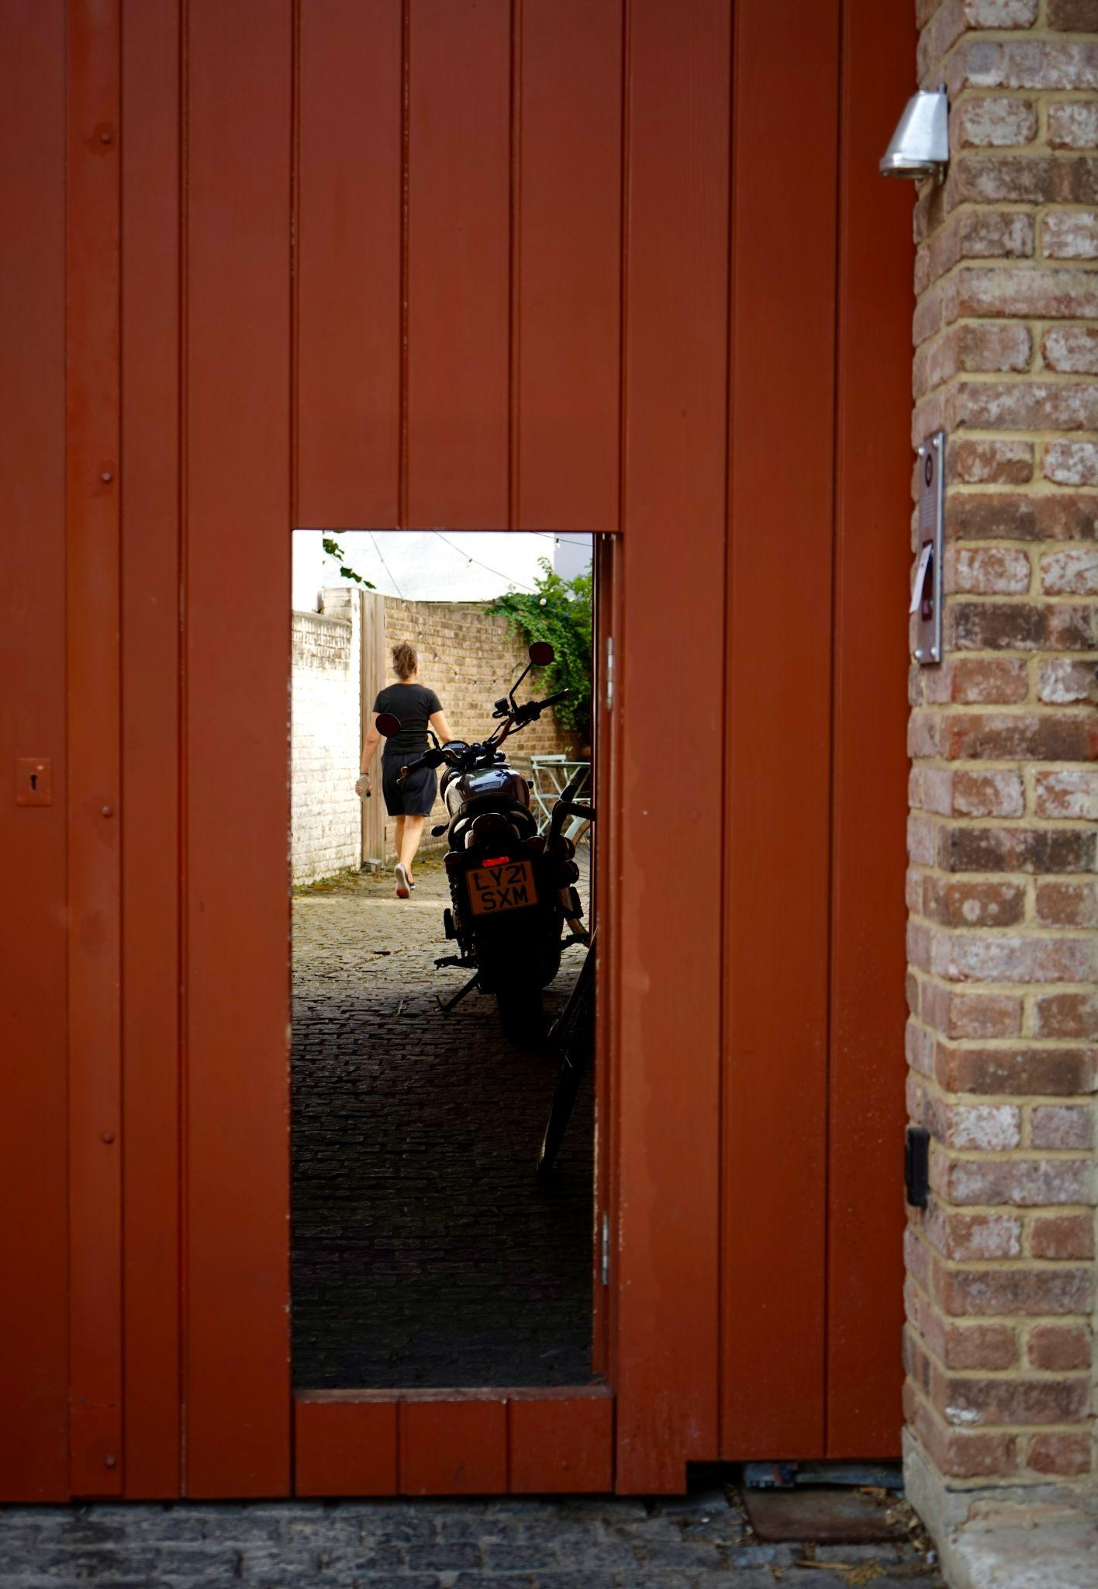
The four sections
Opening up
Learning
Animation
Accessibility

Slide 7
Opening up
Access the usually inaccessible
Access for free (if there’s usually a charge)
Providing one of these scores 2

Slide 8
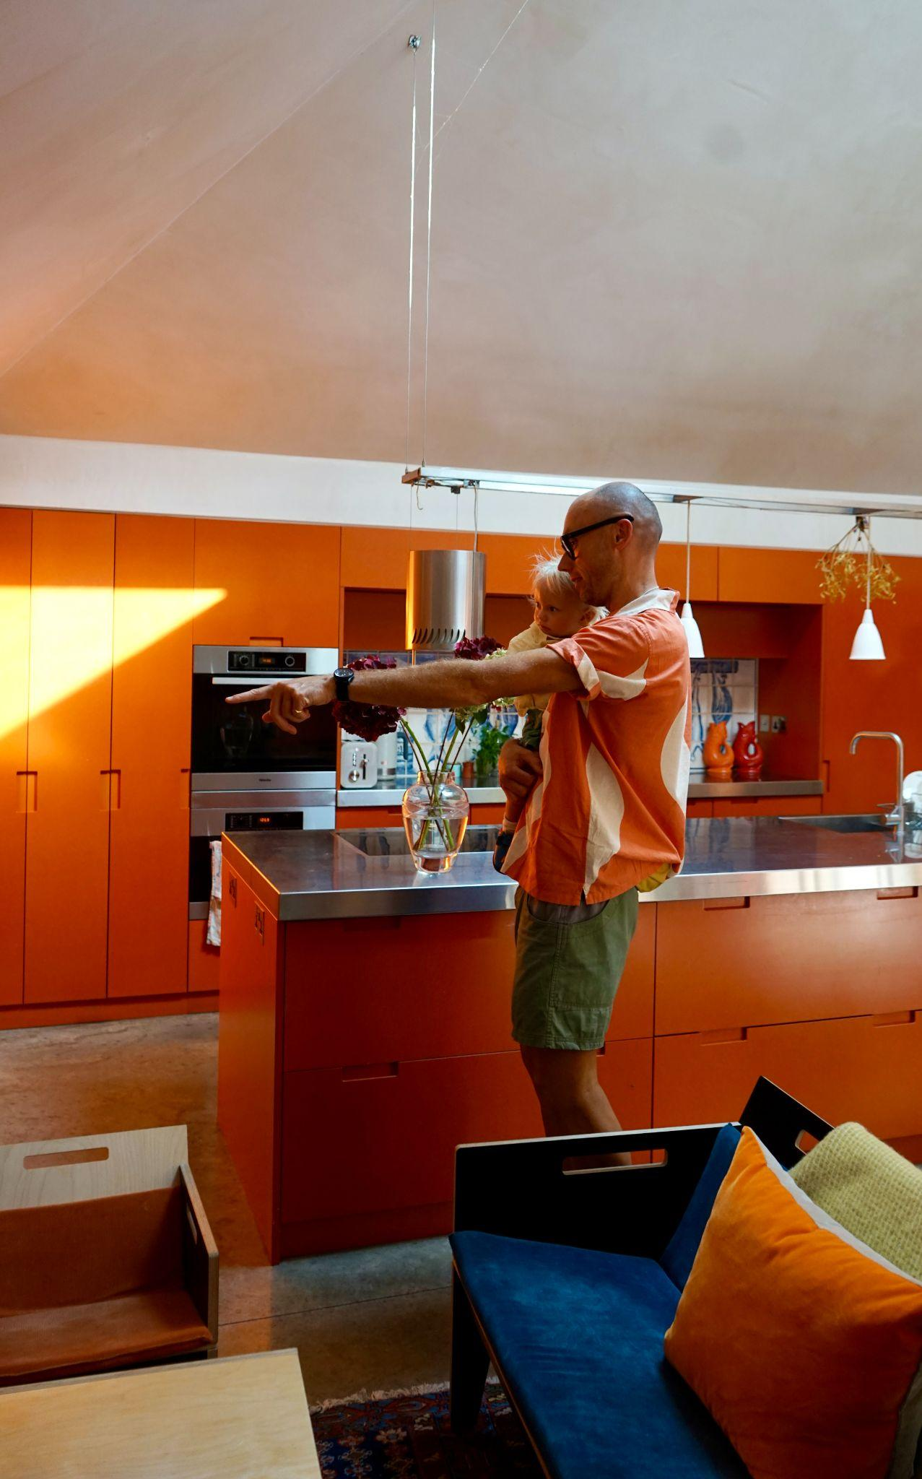
Learning
‘Having something interesting to share’
Introducing, interpreting, explaining the space
Not about being an expert
Especially important if space usually open for free

Slide 9
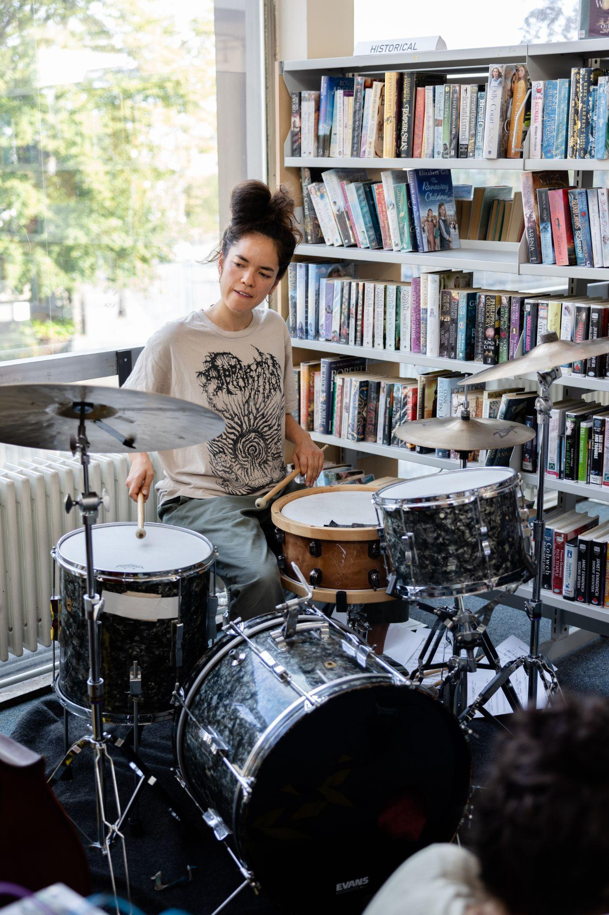
Animation
Something happening in the space
Doesn’t need to relate to the space thematically
Might be about the community or organisation that uses the space
Especially important if space usually open for free

Slide 10
Accessibility
About removing barriers
Criteria lists examples, but other possibilities

Slide 11
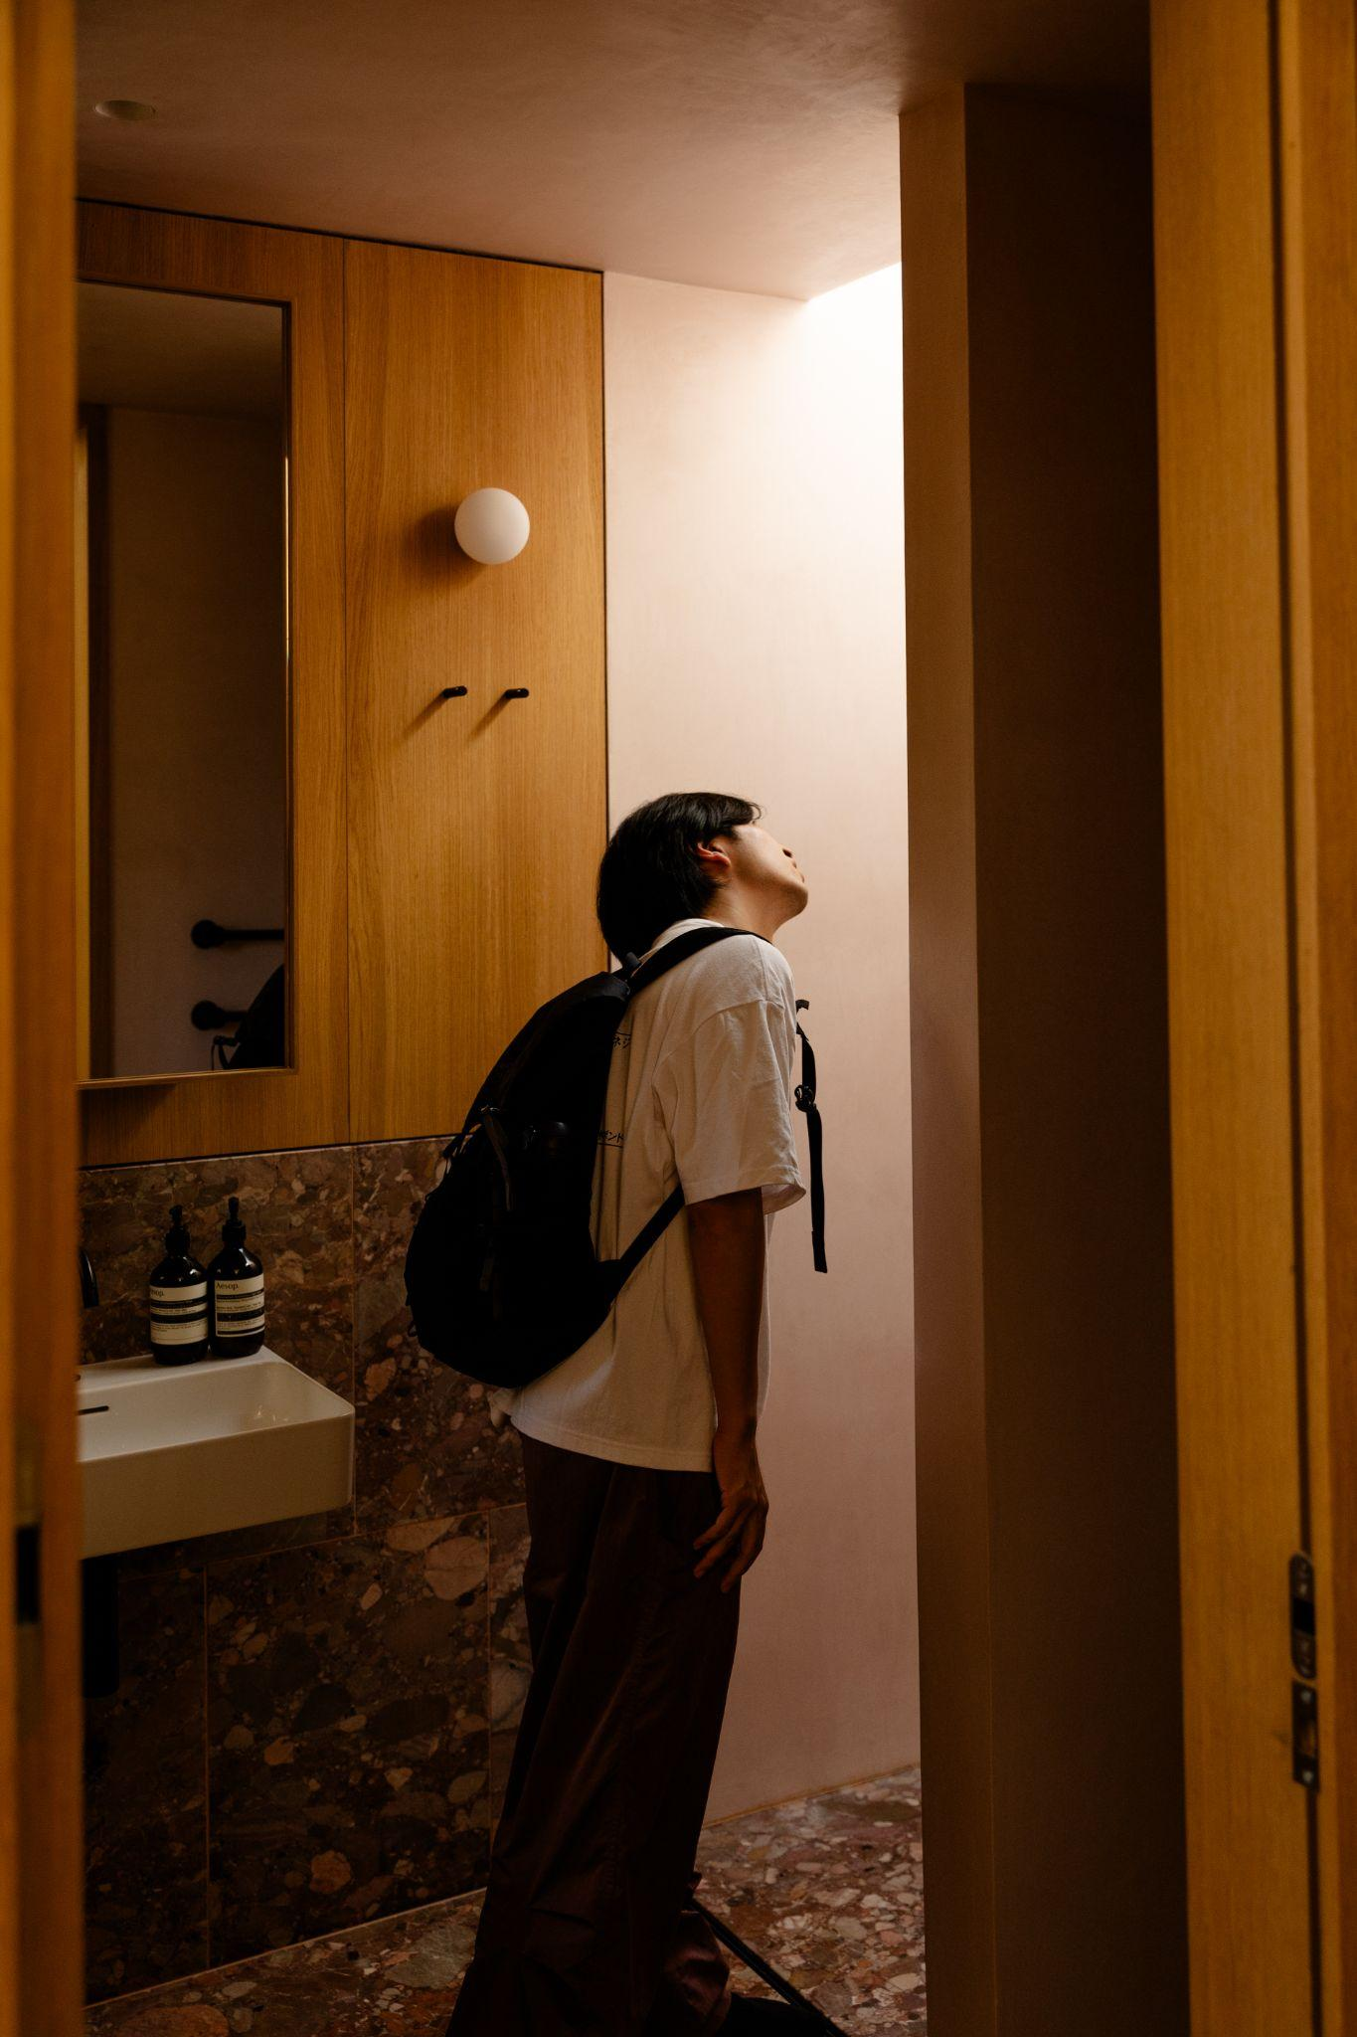
If you’re opening a space for free that isn’t usually open for free, that’s enough

Slide 12
E.g. 2 points for opening + 1 point for a good ‘About’ section = 3

Slide 13
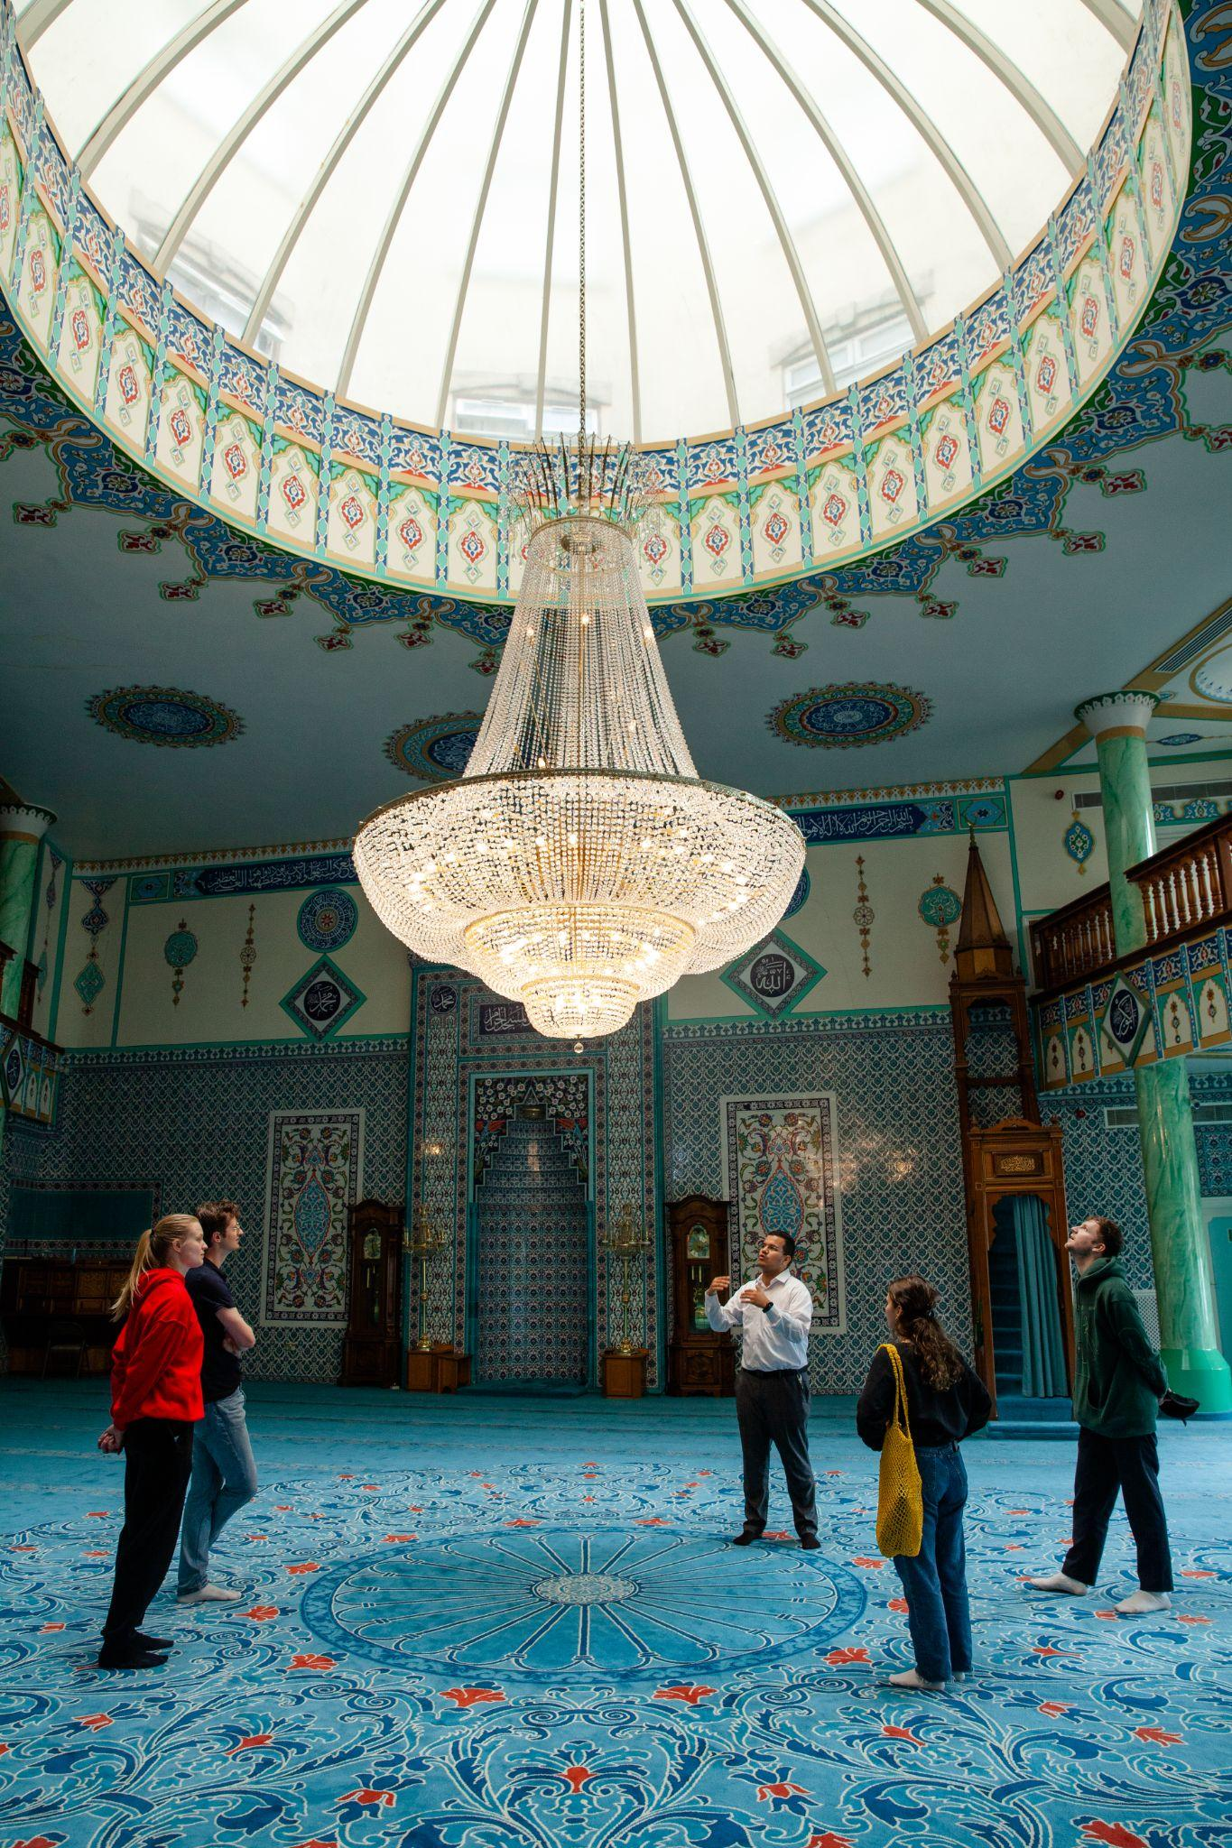
If your space is usually open for free, do a little bit extra for the festival

Slide 14
E.g. 2 points for giving a tour of the building + 1 point for a large print guide = 3

Slide 15
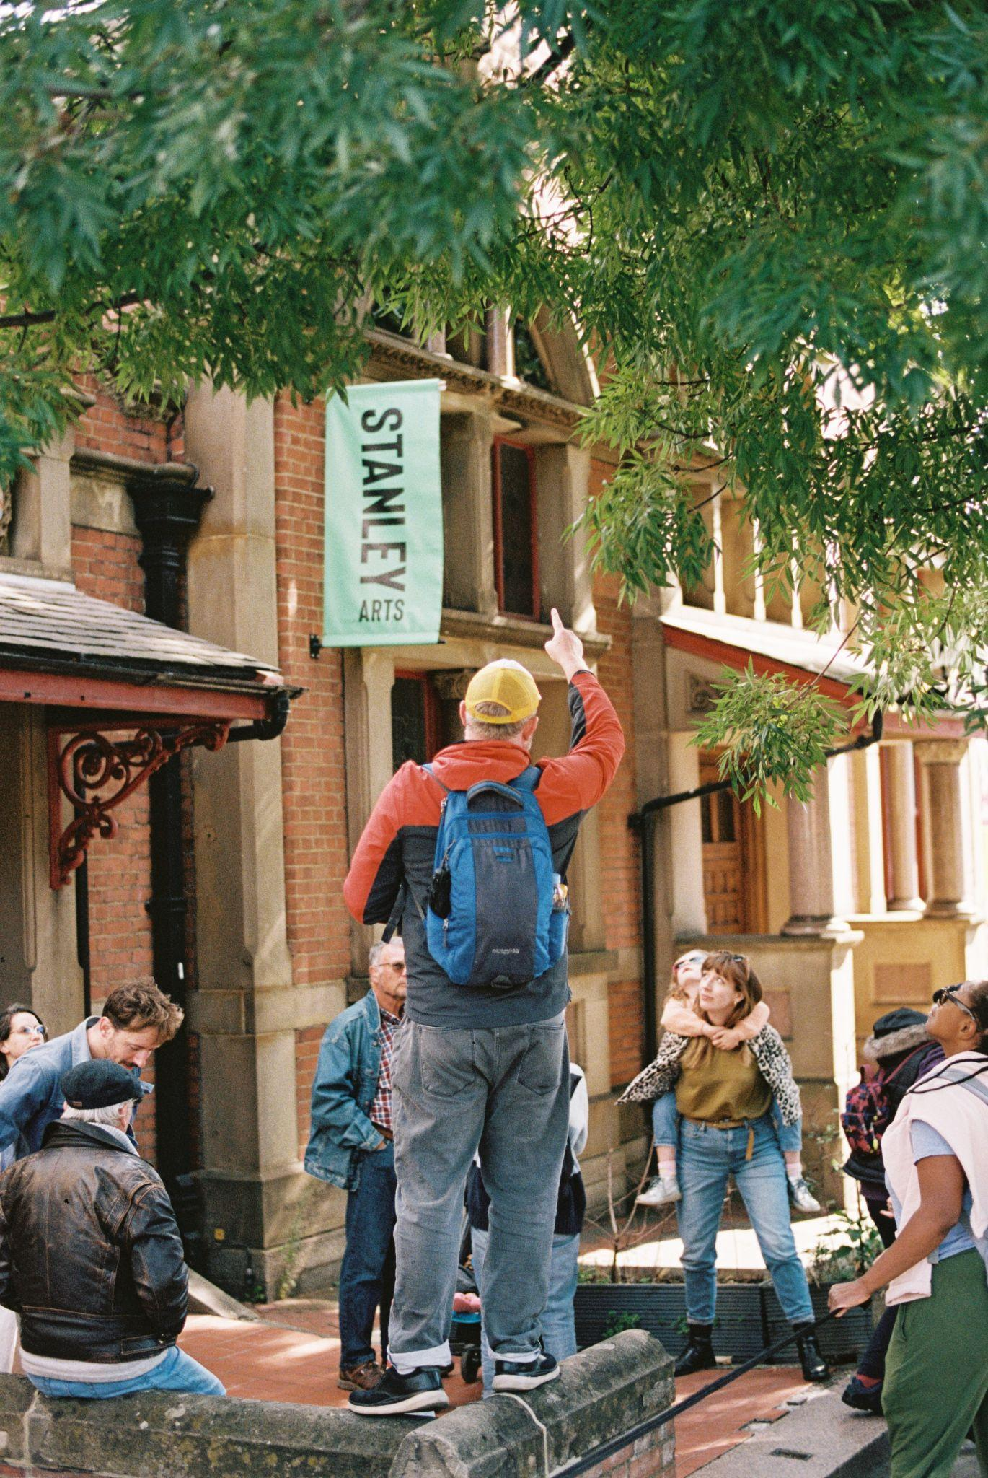
If you’re running a walking tour, you don’t also need access to buildings

Slide 16
E.g. 2 points for the walking tour + 1 point for a good ‘About’ section = 3

Slide 17
Useful things
Webpage - https://open-city.org.uk/open-house-festival-2024
Video guide - https://open-city.org.uk/step-by-step
Written guide - https://rb.gy/y3y45z
Curatorial criteria - https://rb.gy/xo1woc

Slide 18
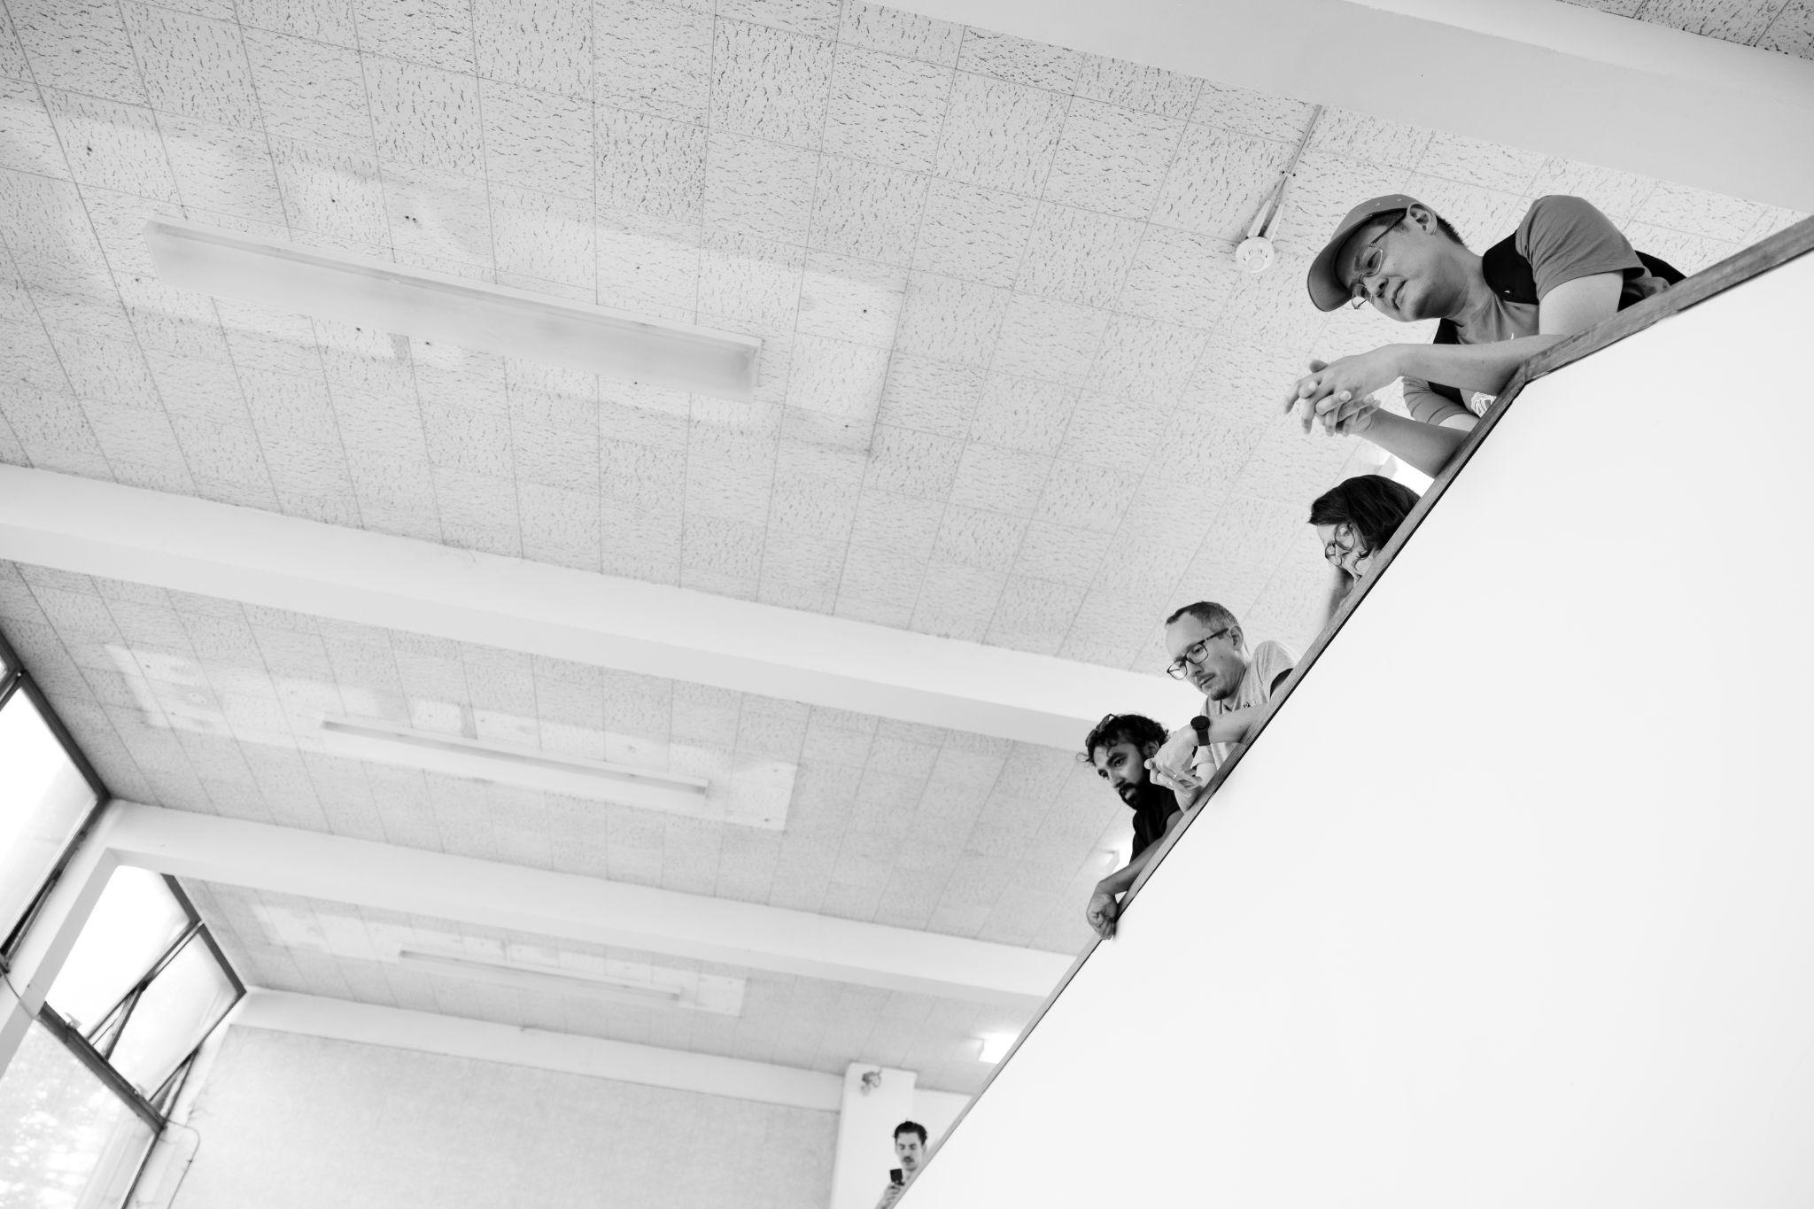
Questions?

